Slide 1
Business Insights & Executive Report
Brazilian E-Commerce Dataset (Olist)
Snapshot date: 2018-08-30
Prepared by: Divana Vikneswaran

Slide 2
Executive Summary
Total revenue (last 12m): $11.9M
Average Order Value (AOV): $160.37
Repeat purchase rate: 0.0%
Median delivery time: 10 days
Avg review: 4.13 (drops to 3.85 when delivery slower than median)
Key Insight: Delivery speed strongly impacts customer satisfaction.

Slide 3
Data Overview
Dataset: Brazilian E-Commerce (Olist)
Orders, Customers, Products, Sellers, Payments, Reviews
Timeframe: ~2016–2018
Snapshot used: up to 2018-08-30

Slide 4
Sales Performance
Total Revenue (last 12m): $11,937,358.55
AOV: $160.37
Payment methods:
- Credit card: 74% of orders ($12.5M)
- Boleto: 19% of orders ($2.9M)
- Debit card + Voucher: small share (<7%)
Insight: Credit card dominates as preferred payment method.

Slide 5
Top Product Categories by Revenue
1. beleza_saude ($1.26M)
2. relogios_presentes ($1.20M)
3. cama_mesa_banho ($1.04M)
4. esporte_lazer ($0.99M)
5. informatica_acessorios ($0.91M)
Insight: Beauty & health, gifts, and home goods are the strongest drivers.

Slide 6
Top Products by Revenue
1. Product bb50f2e... → $63,885
2. Product 6cdd538... → $54,730
3. Product d6160fb... → $48,899
4. Product d1c4270... → $47,214
5. Product 99a4788... → $43,026

Slide 7
Top Sellers by Revenue
1. Seller 4869f7a5... → $229,473
2. Seller 53243585... → $222,776
3. Seller 4a3ca931... → $200,473
4. Seller fa1c13f2... → $194,042
5. Seller 7c67e144... → $187,924

Slide 8
Delivery & Customer Reviews
Median delivery time: 10 days
Avg review (all orders): 4.13
Avg review (slow deliveries): 3.85
Insight: Faster delivery leads to significantly higher customer satisfaction.

Slide 9
Key Business Recommendations
Logistics: Reduce delivery times to improve review scores and retention.
Marketing: Focus campaigns on top categories (Beauty, Gifts, Home).
Payments: Encourage credit card use with loyalty perks.
Sellers: Support high-performing sellers to expand capacity.
Retention: Develop loyalty programs to increase repeat purchases.

Slide 10
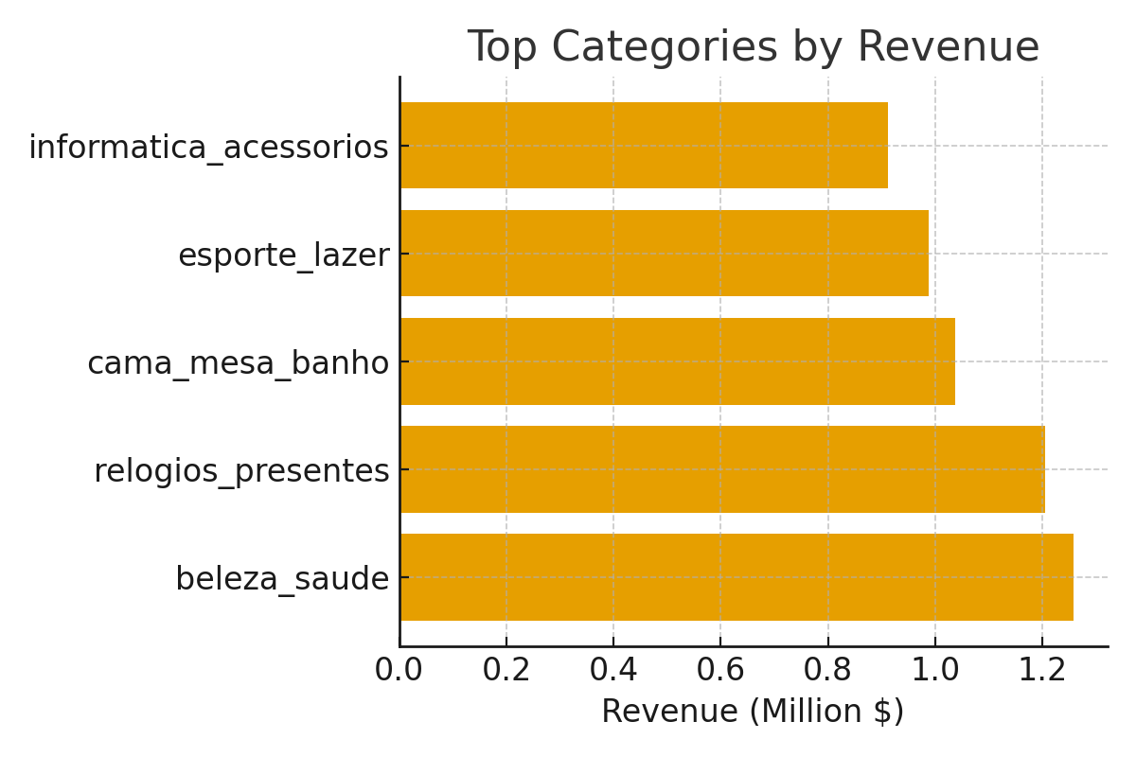

Slide 11
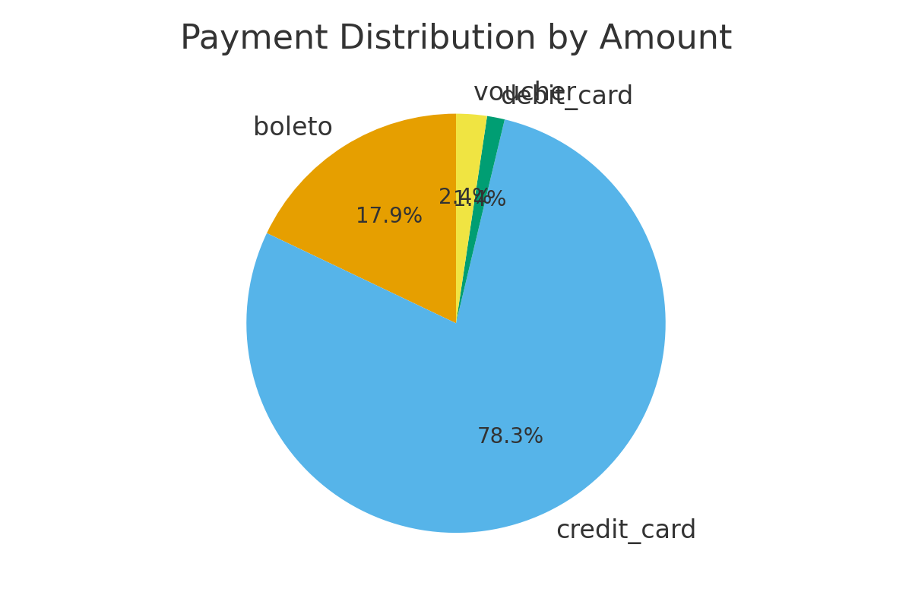

Slide 12
